Slide 1
Smart Gloves using Flex Sensor
Project Supervisor- Suramya Sharma Dahal
Major Project Supervisor- Dipen Manandhar

Slide 2
Contents
Introduction
Objectives
Problem Statement
Applications
Methodology
Gantt Chart
Expected Output

Slide 3
Introduction
This project is a tool for the dumb and deaf to communicate.
It converts sign language into audio that can be heard.
It uses machine learning for fast and accurate expressions.

Slide 4
Objectives
To develop a sensor embedded glove that converts sign language
Help the disabled to communicate

Slide 5
Problem Statement
Dumb people have trouble communicating.
Accidents can cause speaking difficulties.

Slide 6
Applications
For dumb and deaf people to communicate.
In hospitals for injured people.
Input Device for gaming.

Slide 7
Methodology
Hardware Assembling
Dataset Preparation
System Block Diagram
Flowchart

Slide 8
Hardware Assembling
Connect MPU6050 with accelerometer and gyroscope.
Interface flex sensor and MPU6050 to Arduino Mega 2560.
Connect the Arduino Mega 2560 to laptop to send data.

Slide 9
Dataset preparation
Receive data from Arduino Mega 2560 and write to file.
Classify data and convert the file to csv file format.
Use Random forest classifier in python to train the model.

Slide 10
Flowchart for Dataset preparation

Slide 11
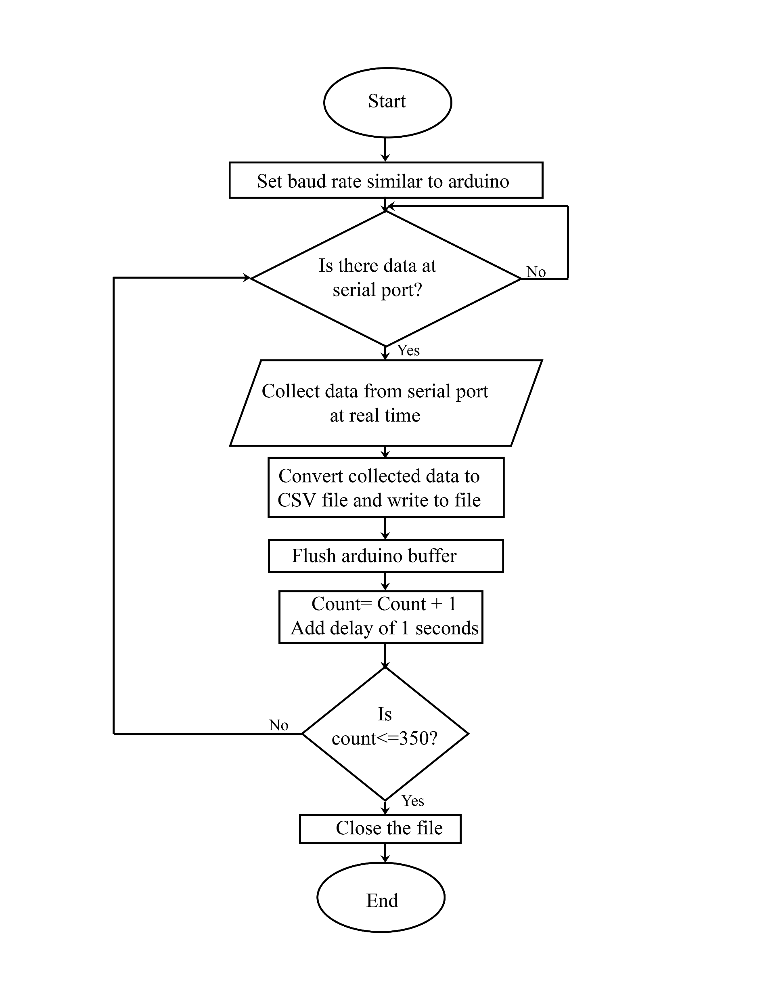

Slide 12
Flowchart for real time application

Slide 13
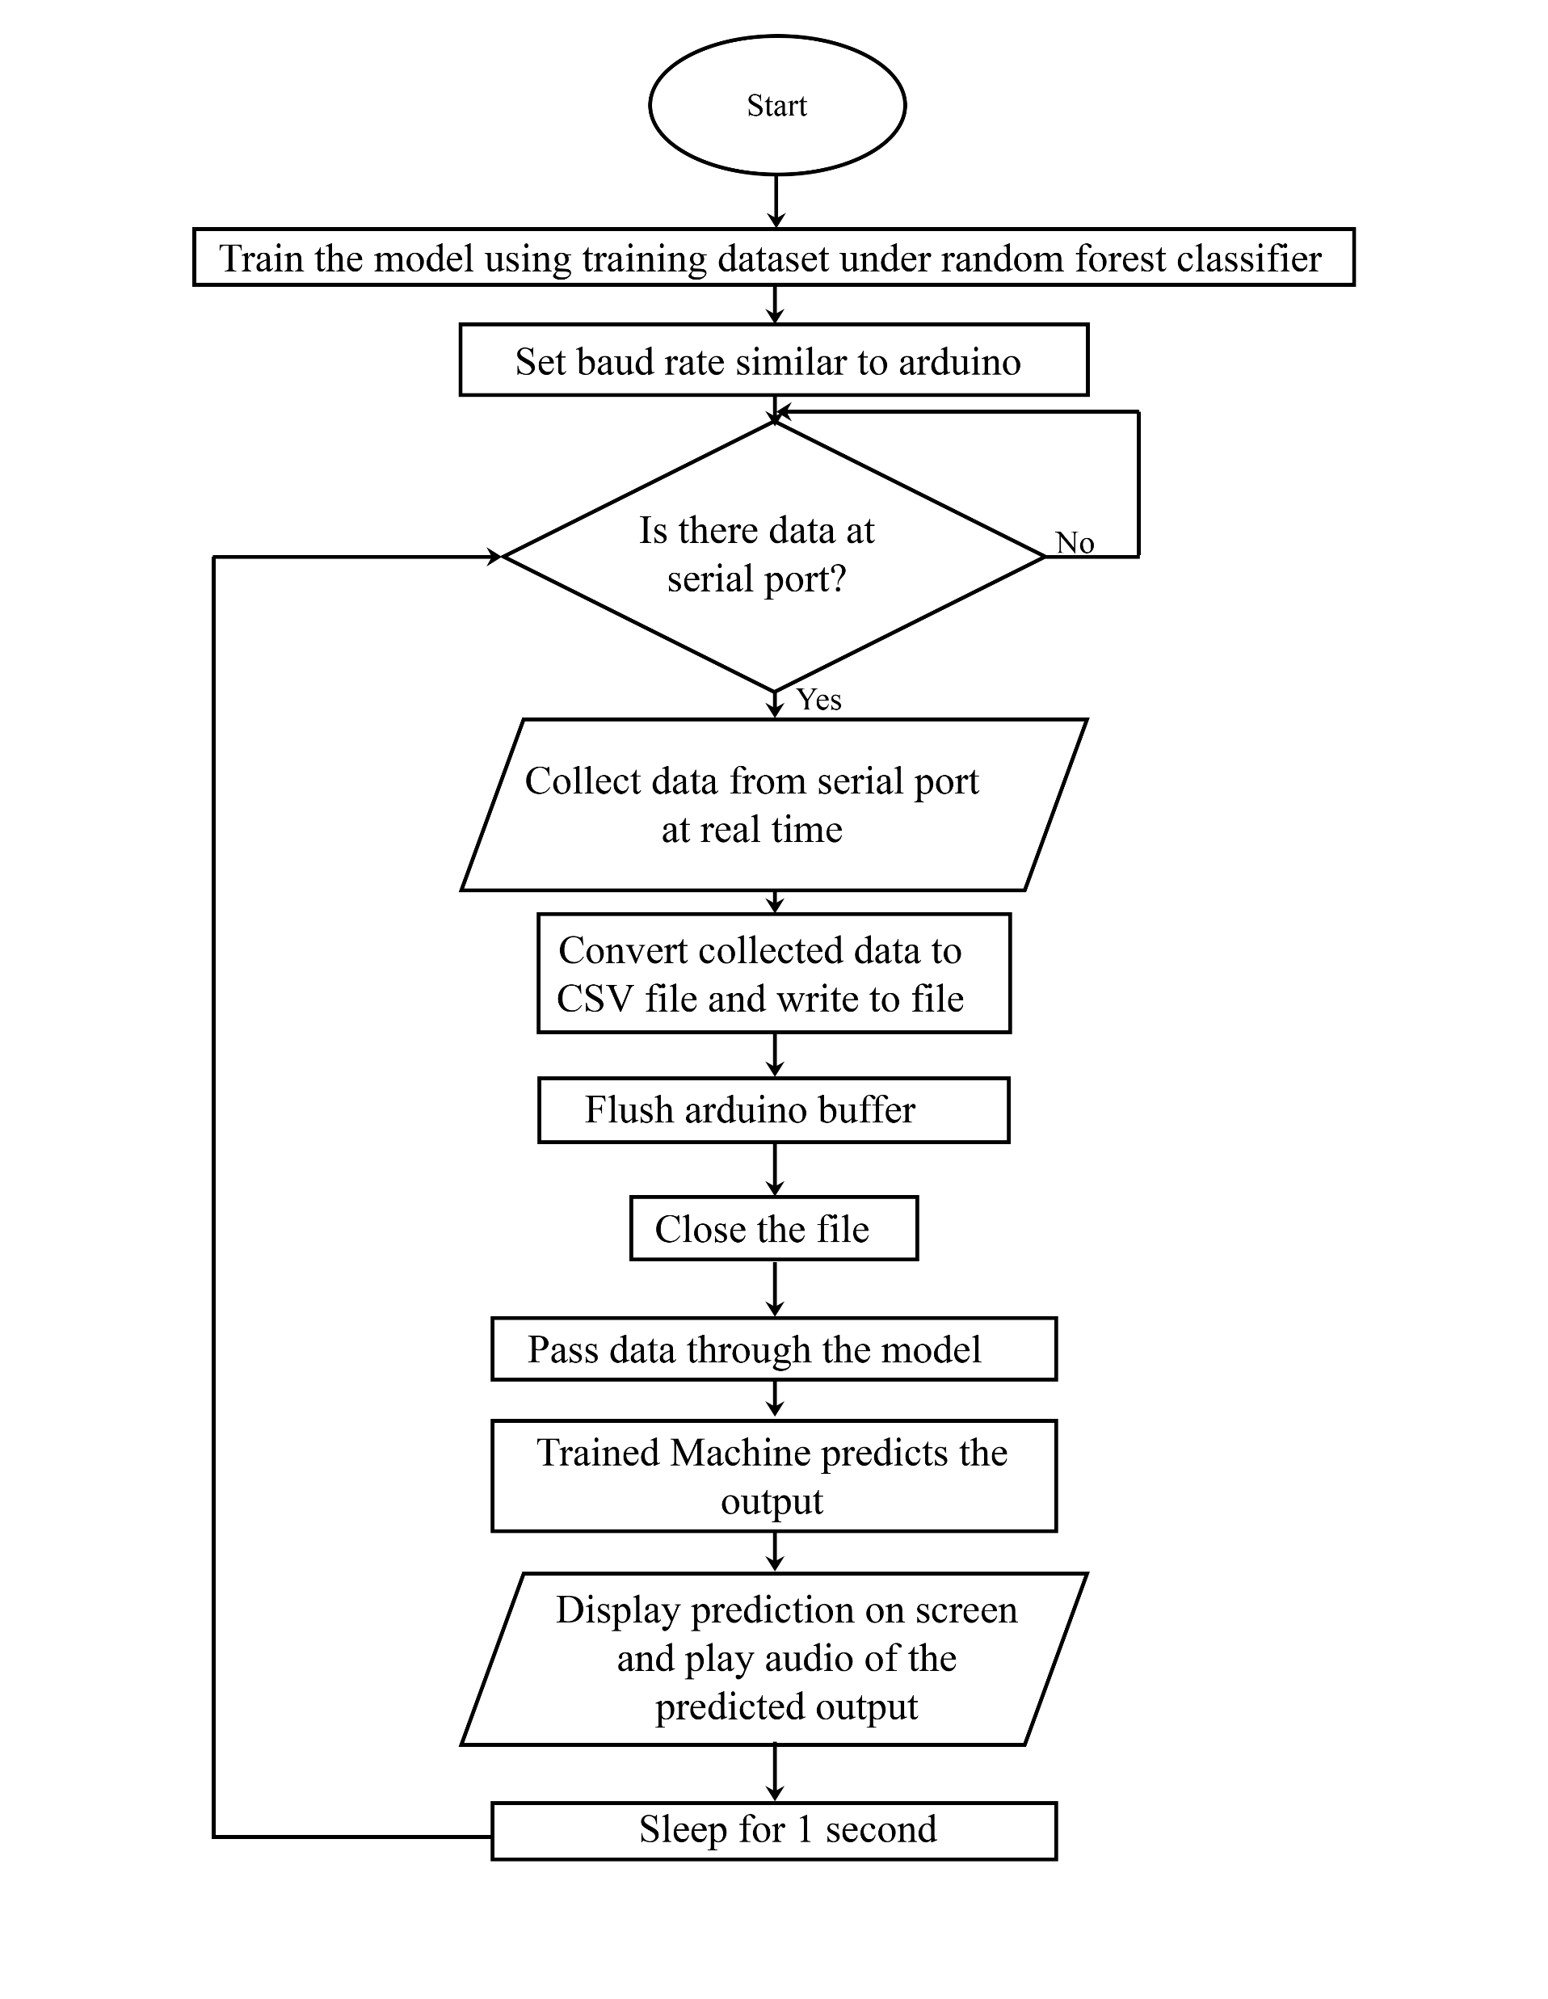

Slide 14
Gantt Chart

Slide 15
Expected Output

Slide 16
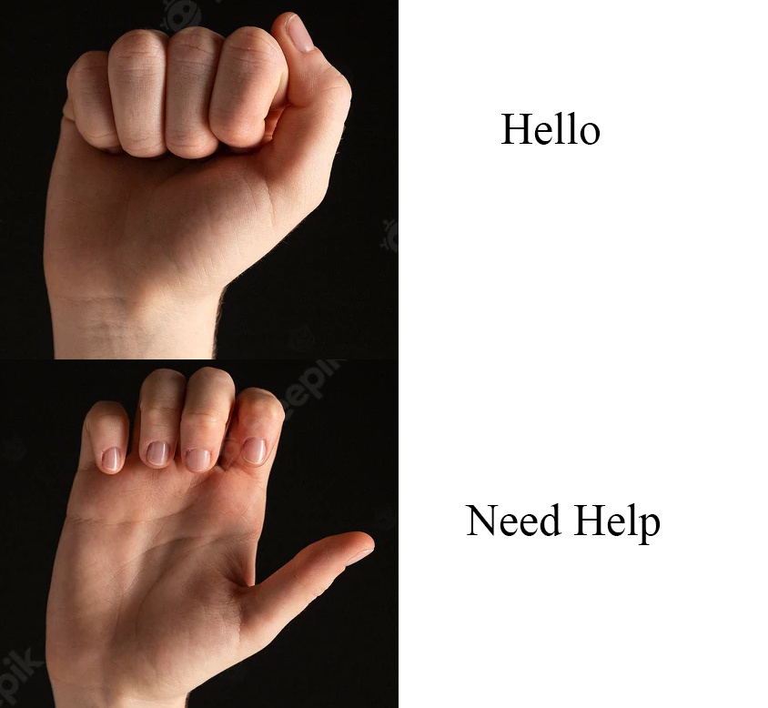

Slide 17
